Slide 1

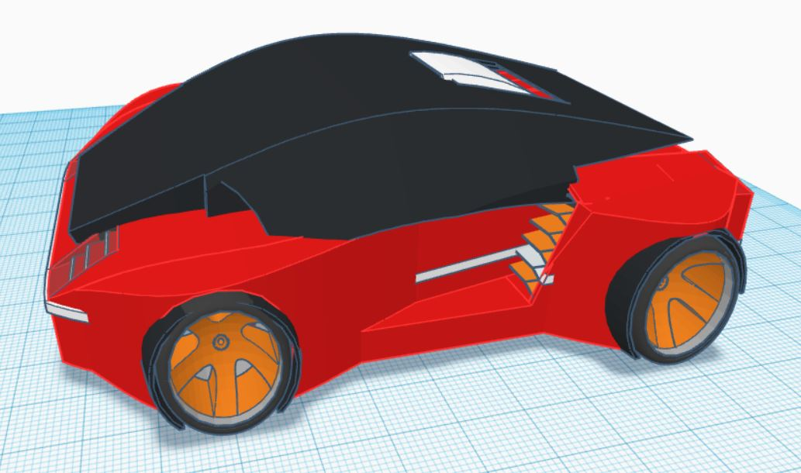
SAM (Schedulable Autonomous Mower)
- For those who want to love their Lawns again!
-Shubham Pawar

Slide 2
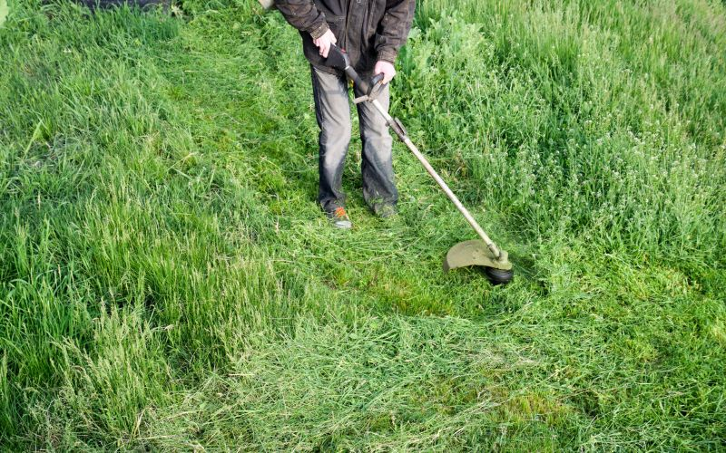
Overview
Tired of maintaining the Lawn?
No time as well?
Our Solution:- Introduction of State of the Art Lawn Mower

Slide 3
Features
Autonomous
Safe and Secure
Simple User Interface

Slide 4

Features - Autonomous
Scheduled Start
Obstacle Avoidance
Boundary Detection
Battery Monitoring
Go to Charge Station
Weather Check

Slide 5
Features – Safety and Security
Emergency Stop Button
All motors stop when the Mower is lifted
Also send a notification to the Smartphone
Can only be accessed through Pre-defined local network

Slide 6
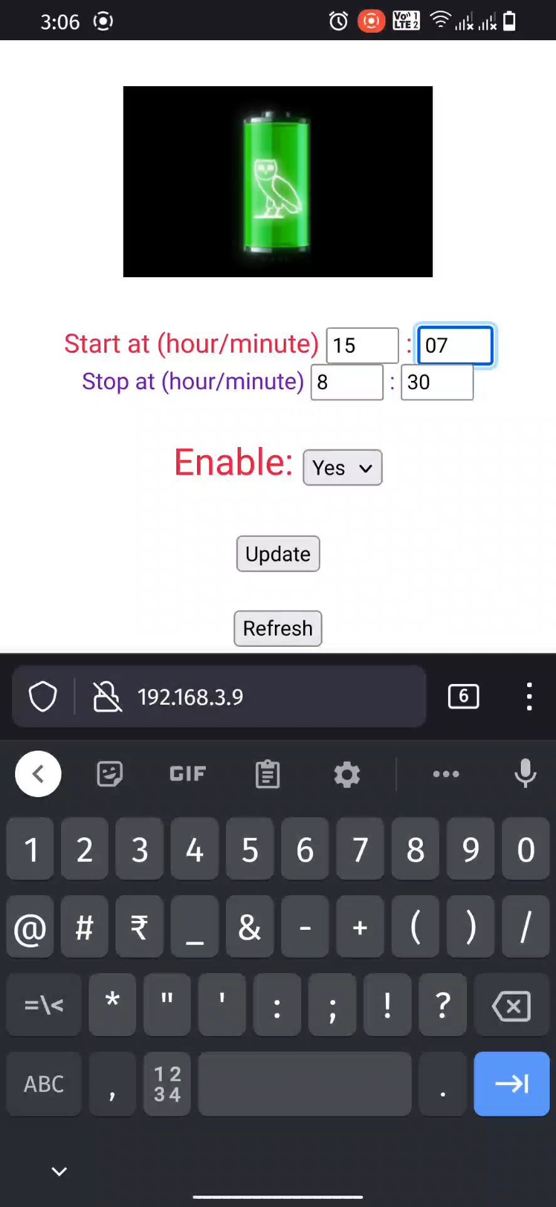
Features – Simple User Interface
Set Schedule
Visualization of Current Status
Multilingual
Battery Charge level Monitoring
Emergency Stop Button
Show Current Weather Status

Slide 7
Applications
For small household lawns
For big lawns with multiple mowers

Slide 8
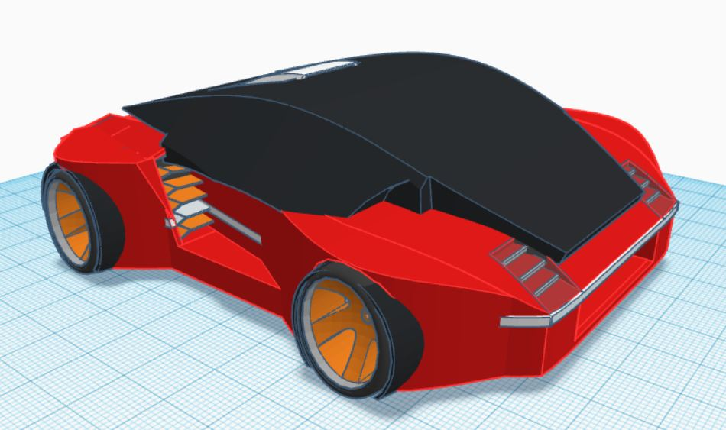
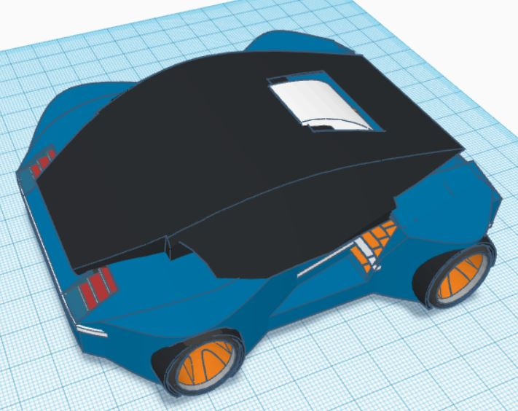
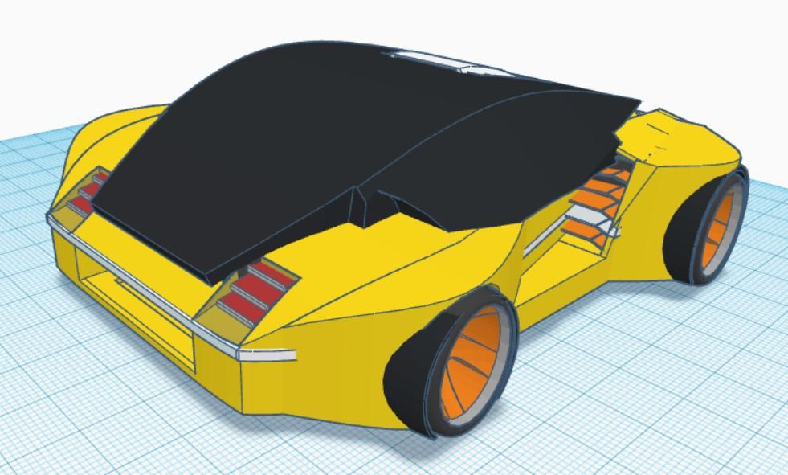
Pricing and Availability
€100 for the base model
Accessories will cost more*
Following colors are available
The product will be available from 2022 in local as well as online stores.
Contact +49 17646744118 for more information.

